Slide 1
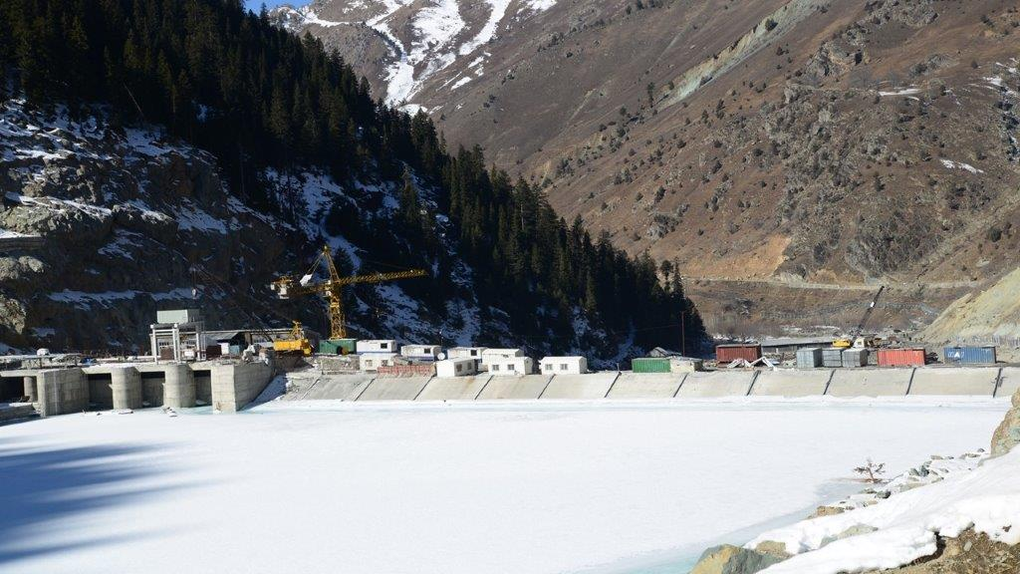
SEMINAR ON KISHANGANGA HYDRO ELECTRIC POWER PROJECT
PRESENTED BY
ASHIQ HUSSAIN
SECTION : B
ENROLL: 4696
DEPARTMENT OF CIVIL ENGINEERING
SSM COLLEGE OF ENGG AND TECHNOLOGY

Slide 2
CONTENTS
1. INTRODUCTION
2.LOCATION
3.PROJECT COMPONENTS
3.1 CFR DAM
3.2 SPILLWAY
3.3 DIVERSION TUNNEL
3.4 INTAKE
3.5 HEAD RACE TUNNEL
3.6 SURGE SHAFT
3.7 PRESSURE SHAFT
3.8 POWER HOUSE
3.9 TUNNELS IN POWER HOUSE
4. TALE RACE SYSTEM
5.BENEFITS
6. LOCAL CONCERNS
7. CHALLENGES
8.CONCLUSION

Slide 3
INTRODUCTION
The KHEP is an $ 864 million power project , which is part of a run of a river hydro electric scheme that is designed to divert water from kishanganga river to a power plant in jhelum river basin.
The owner of the project is NHPC and HCC executed the project for NHPC . The design of the project was given by a British company HALCROW.
The installed capacity of this project is 330 MW.
Construction started in 2007 and was expected to be complete in 2016.
Due to many reasons the project got delayed by 2 years and was inaugurated on 19 MAY 2018.

Slide 5
Project location
The dam of KHEP is located in kanzalwan Gurez about 150 kms from Srinagar.
Power house is located in kralpora Bandipora about 80 kms from srinagar.

Slide 6
PROJECT COMPONENTS
1. DAM
2.SPILLWAY
3. DIVERSION TUNNEL
4.INTAKE
5.HEAD RACE TUNNEL
6.SURGE SHAFT
7. PRESSURE SHAFT
8.POWER HOUSE COMPLEX
9.TAIL RACE SYSTEM

Slide 7
CFR DAM
The project includes a 37 m ( 121 ft.) concrete face rock fill dam which will divert a portion of of the kishanganga river south through a tunnel.
Rock fill dams are resistant to earthquakes.
CFRD is a rock fill dam with concrete slabs on its upstream side .
CFRD is resistant to uplift pressure

Slide 8
SPILLWAY
The type of spillway used is chute spillway .
The energy dissipation is carried out through flip bucket.
The spill ways are designed for design flood of 2000 cumec .
No. of gates used are 3 with size of( 7.0* 9.5) m

Slide 9
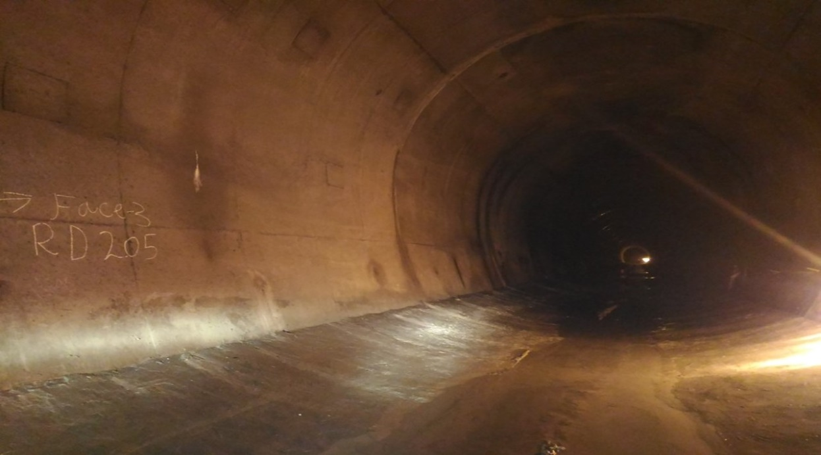
DIVERSION TUNNEL AND INTAKES
NO: 1
DIVERSION CAPACITY: 1000 cumec
LENGTH: 569 m and DIA.= 9.5 m
INTAKE NO. : 2 SIZE: 4.25 * 2.5 m
LENGTH: 86 m

Slide 10
HEAD RACE TUNNEL
Size and shape – 6.2 m HSS (DBM)/ 5.2 m circular ( TBM)
Length : 23.2 km (14.7 km TBM & 8.5 km DBM)
The tunnel crosses geological formations composed of basalt , meta- sandstone, meta siltstonewith over burden upto 1300m.
New specific TBM was used.
TBM is a universal double shield with diameter of 6, 18 m , which installs hexagonal precast segmental lining.

Slide 11
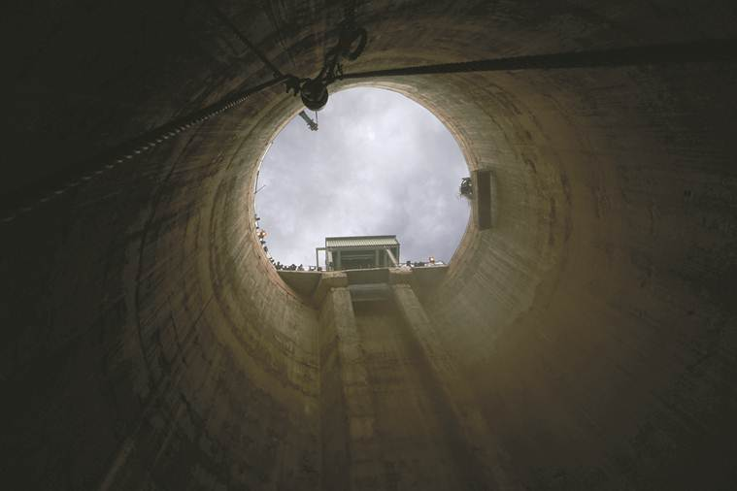
SURGE SHAFT
DIA.: 17.75 m & HEIGHT OF 109.7 m
The tunnel is received by a surge chamber before sending water to the underground power house.
The surge shaft is used to moderate the flow and absorb a sudden increase in water pressure.

Slide 12
PRESSURE SHAFT
NO. : 1
Type : Circular inclined , steel lined fully .
DIA. : 4.0 m trifurcating into 3 horizontal branches at bottom .
Length 1020 m

Slide 13
POWER HOUSE COMPLEX
The 330 MW underground power house has 3 units of 110 MW capacity .
Gross head is 670.2 m and net rated head of 646 m .
The energy generated per annum is 1713 MU in a 90% dependable year.
The main advantage of underground power houses is safety from airstrikes.

Slide 14
Main access tunnel and ventilation tunnel
Size and shape: 8m*8m,d shape
Length:740m
VANTILATION COM CABLE TUNNEL
Length:645m
Size and shape:4.7m*5.4m,D shape

Slide 15
TAIL RACE SYSTEM
TUNNEL:
Size and shape:5.0m,HS
Length=903m(approx)
OPEN CHANNEL
Length = 36m
SWITCHYARD
Size 191m*115m

Slide 16
BENEFITS
In addition to generating 330 mw power , the diverted water is used for irrigation or to generate additional power.
The benificiary states are J&K , Himachal Pradesh , Rajasthan , Uttaranchal , Punjab , Haryana , uttarpradesh , chandigarh and New delhi.
12% of power will be given to J&K as royalty.
1% of revenue generated per year will be spent on the development of local area.

Slide 17
LOCAL CONCERNS
In 2013 local population of Bandipora protested against HCC , accusing company of causing severe damage to natural environment.
Following sustained protests by villagers in 2012 & 2013 , the hydrology department of NIT conducted tests in the area .
The tests revealed high concentration of dissolved solids and and unsafe alkaline levels in the water.
The water can neither be used for the human consumption nor for washing .

Slide 18
DIFFICULTIES
TRANSPORTATION CHALLENGES
Gurez is cut from rest of j&k for about six months .
TBM was transported in 16 containers .
Workers could not work in open due to cold temperature.
Hazard of working at LOC was felt in 2016.

Slide 19
CONSTRUCTION CHALLENGES
The winter temperature falls as low as -37 degree C .
HCC adopted Russian method of working .
Water was heated to about 50 degrees C , so that it was required 10 degrees C at the time of pouring.

Slide 20
CONCLUSION
NHPC expolited the inability of JKPDC to construct the power projects , because of lack of economic resources.Thus our resources have been used for very low cost and in return we get electricity at high rates , which we should have got free of cost.

Slide 21
THANK YOU

